Slide 1
Chatbot for Multi-Format Documents
Architecture & Flow
A streamlined PDF chatbot using LangChain with HuggingFace embeddings, built for answering user queries from uploaded documents.

Slide 2
Architecture
Component | Role
Loader | LangChain loader to extract and chunk from uploaded documents (PDF, DOCX etc.)
Embedding Process | Applies HuggingFace embeddings to convert chunks into vectors
Vector Store | Uses FAISS (Facebook AI Similarity Search) to store and retrieve relevant chunks
Prompt Template | Combines query and retrieved chunks to guide the LLM
LLM | Uses DeepSeek Model via OpenRouter API with context-aware answers
Streamlit UI | For Frontend that sets for user interaction having page config, title, and description.

Slide 3
Flow
User Input
(Document + Query)
Streamlit Frontend
(Upload + Query)
Loader
(load + chunk text)
Embedding Process
(Vectorize chunks)
LLM
(QA Generation)
Prompt Template
(Query + Chunks)
Vector Store
(Semantic Search)
Final Response (Displayed back to the user)

Slide 4
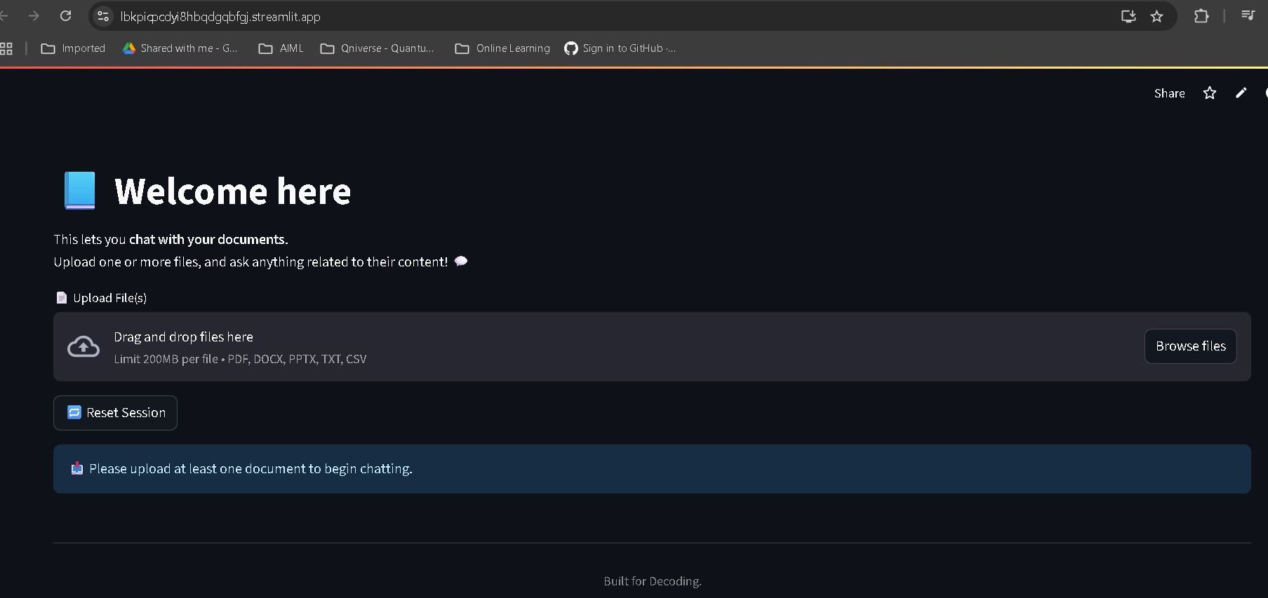
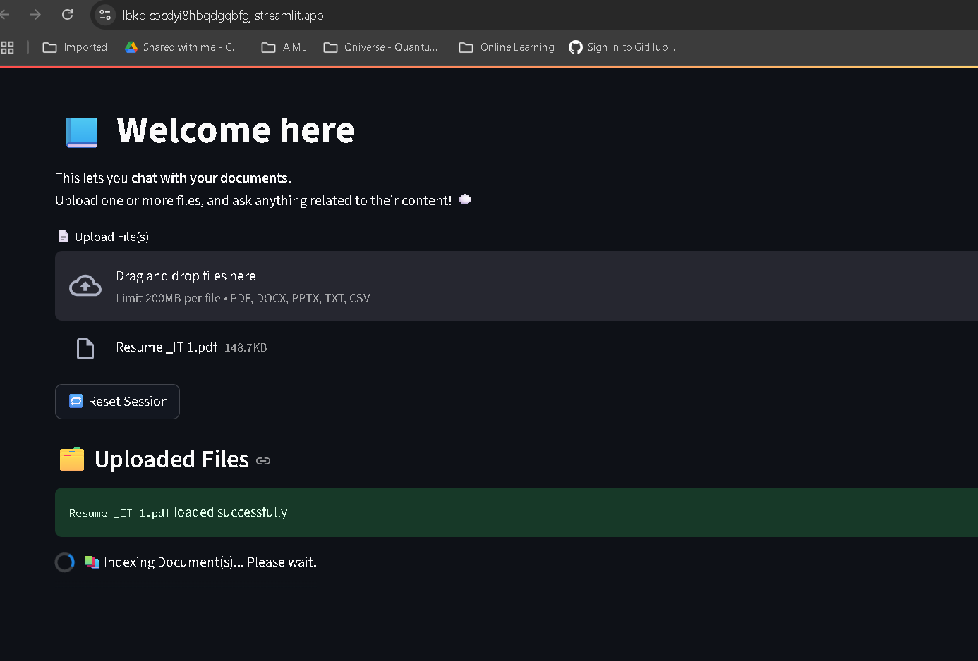
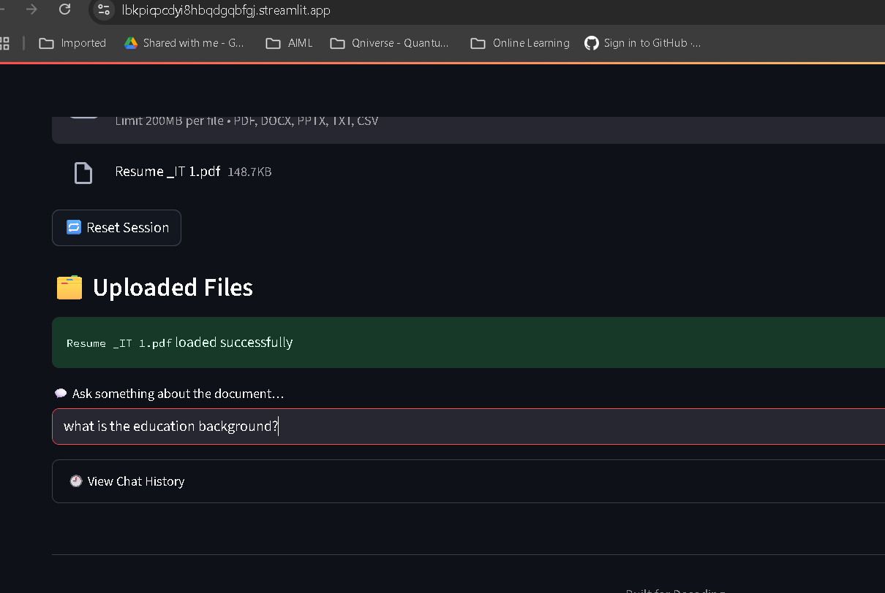
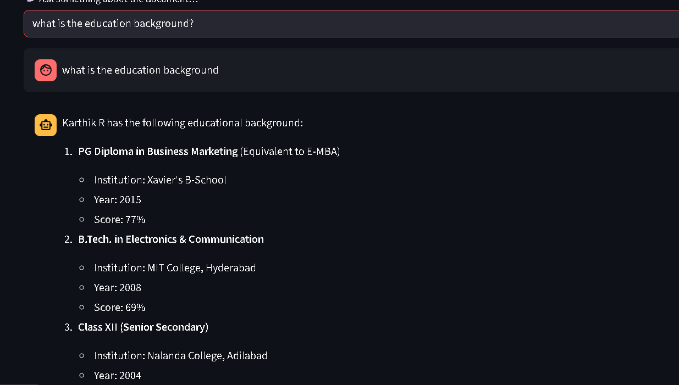
Screenshots
PDF
Home Page
User Input
User Query
Response

Slide 5
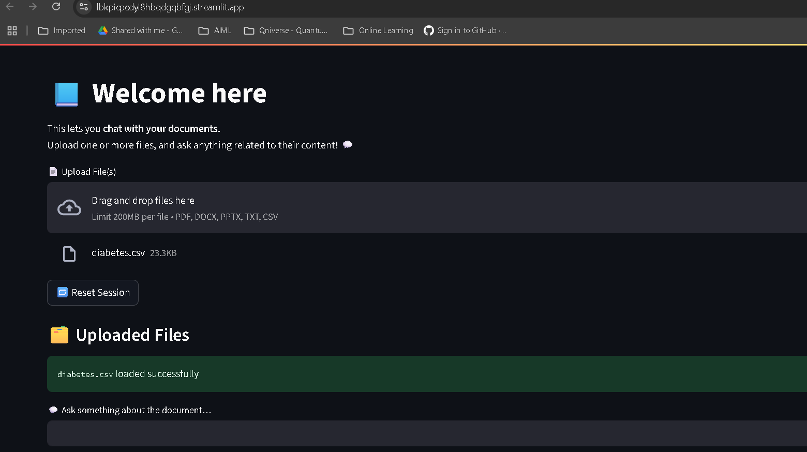
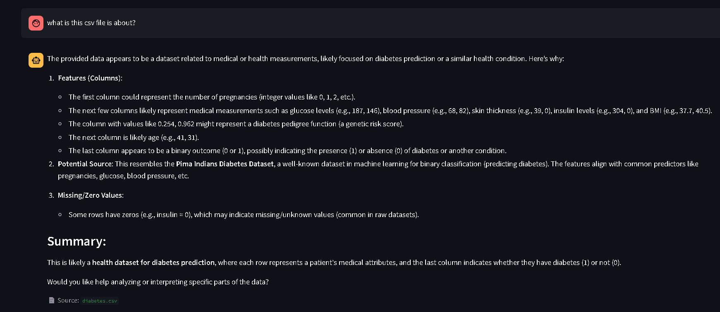
Screenshots
CSV
Home Page
User Input
User Query
Response

Slide 6
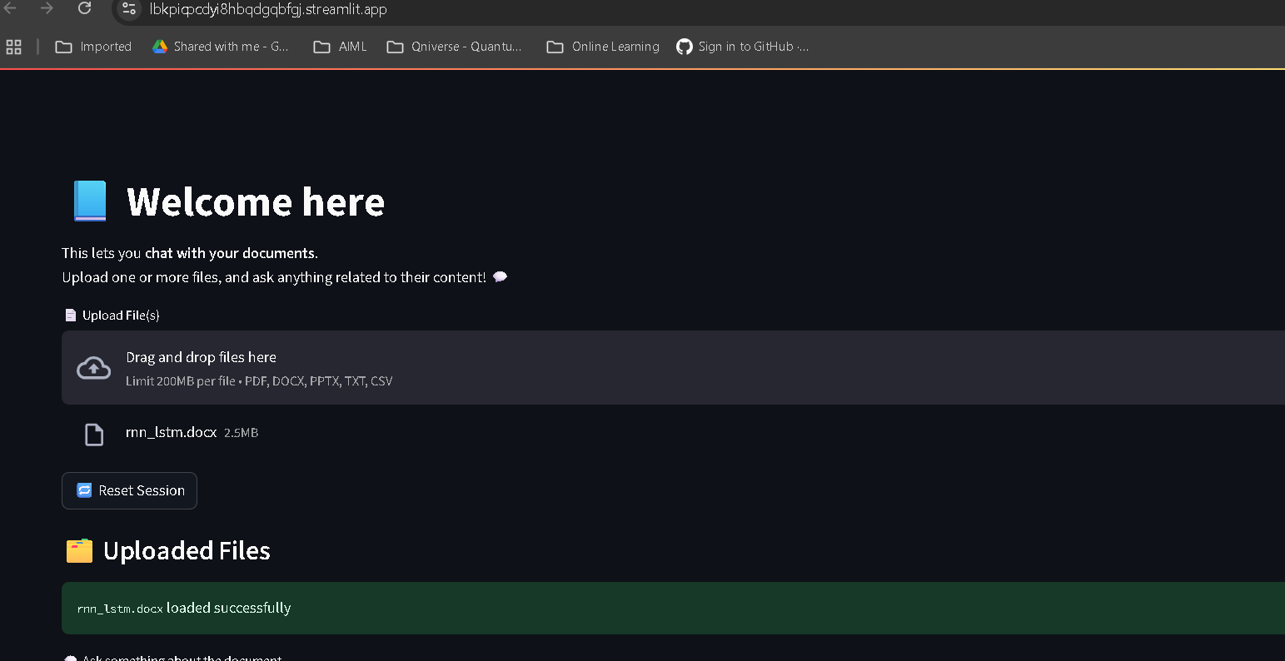
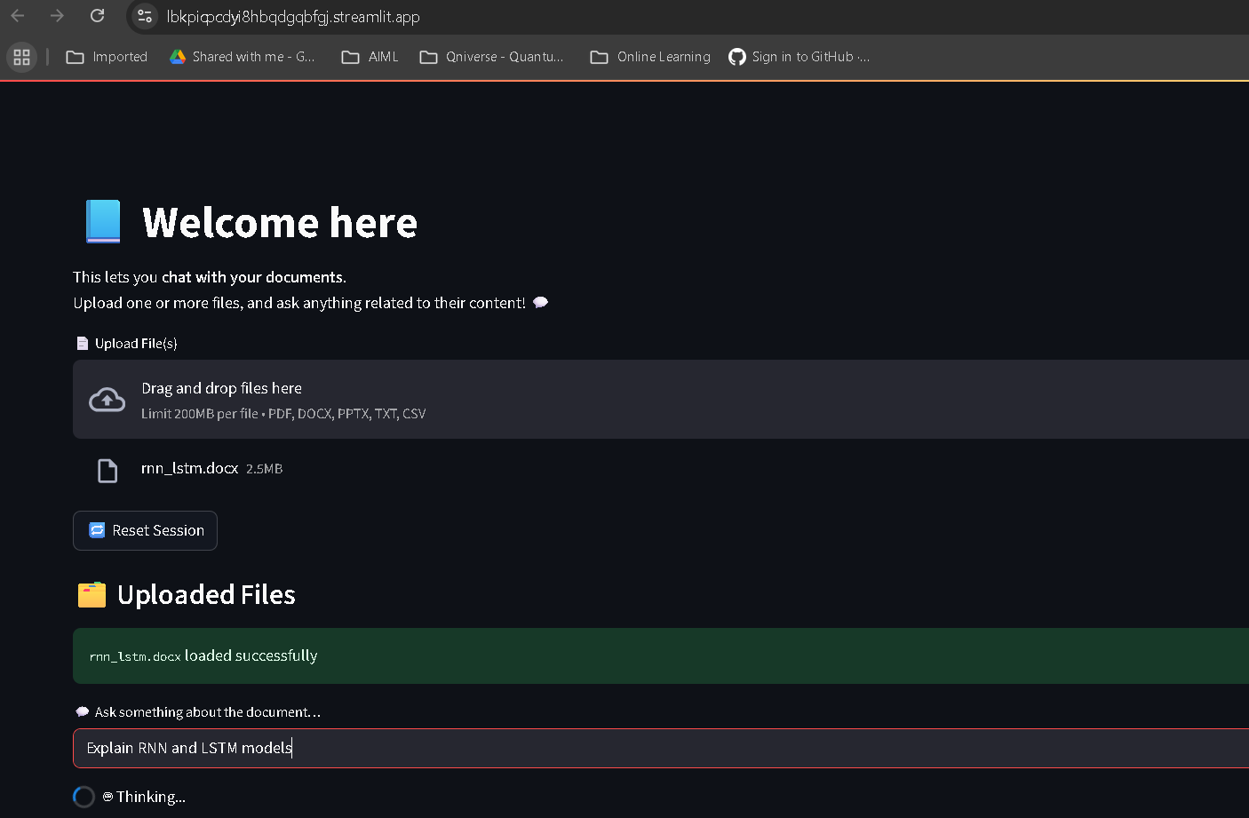
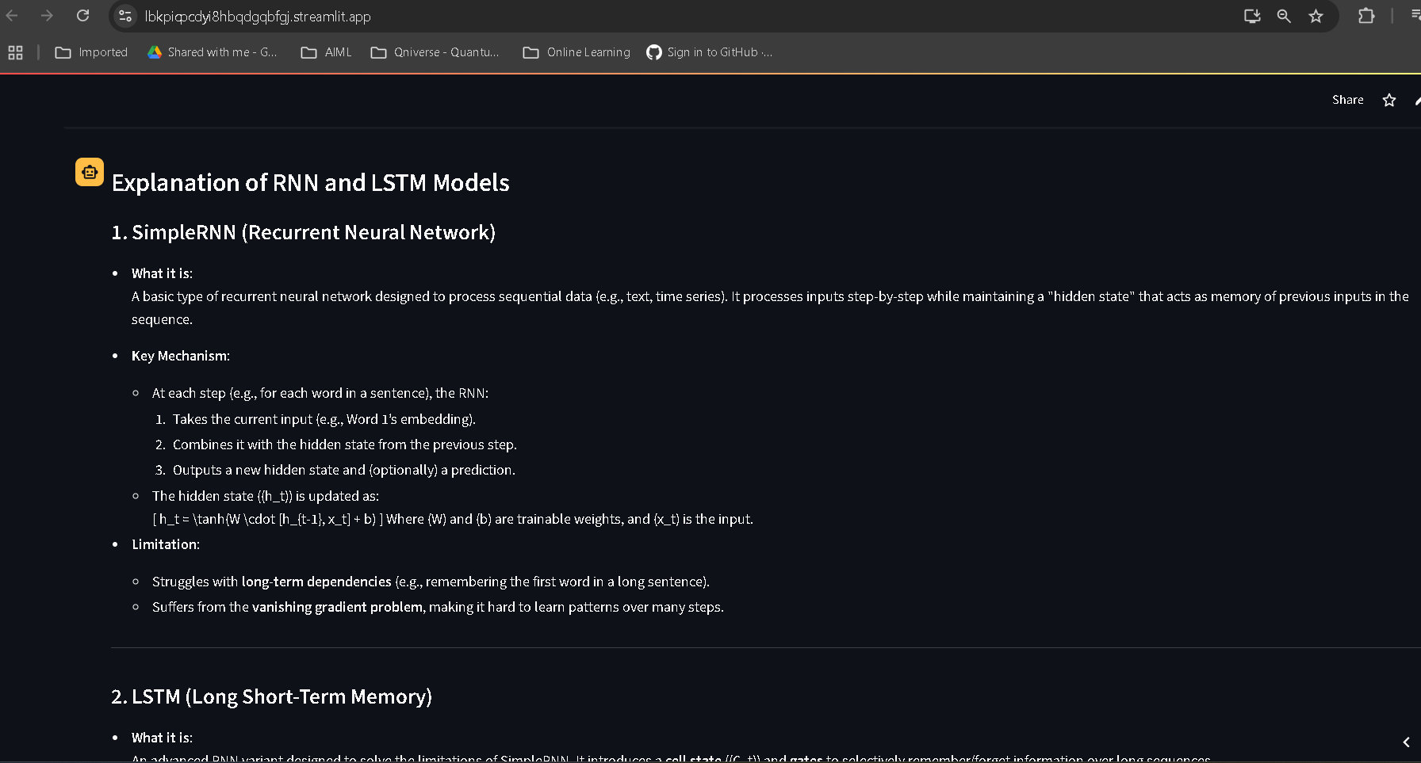
Screenshots
DOCX
Home Page
User Input
User Query
Response

